Slide 1
Work Zone Traffic Management: What Does the Future Hold?

Slide 2
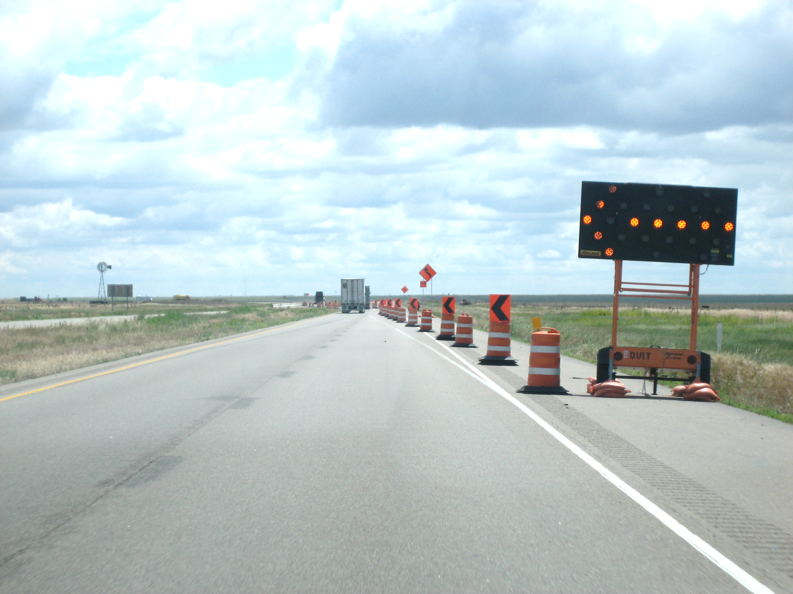
Presentation Topics
Influence of Connected/Autonomous Vehicle Development and Adoption
Connected Work Zone Technology Initiatives
FHWA Work Zone Data Exchange/Data Initiative

Slide 3
Connected vs. Autonomous Vehicles
Connected Vehicles
  Vehicles communicate with each other and with the infrastructure
  Provide warnings and guidance to the human driver
Autonomous Vehicles
  Vehicles perform some (SAE Levels 1-3) or all (SAE Levels 4-5) of the driving tasks
  Examples: Advanced Driving Assistance Systems (ADAS), autonomous shuttles
  Connected Autonomous Vehicles (CAVs) May Combine Features of Both

Slide 4
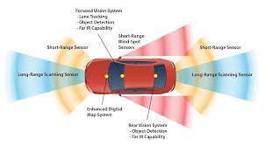
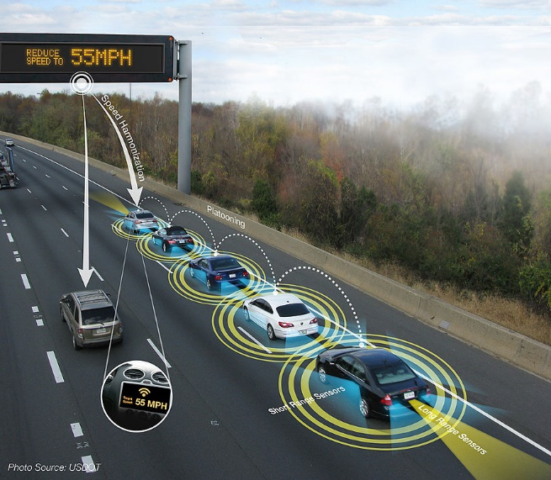
CAV “Information” Sources
Environmental
  Sensors that “see” the roadway environment
  Lidar, radar, machine vision, etc.
Wireless data communications
  Free-form alerts (smartphone apps)
  Standardized “messages”
Notes:
Standardized messages include the BSM and TIM SAE

Slide 5
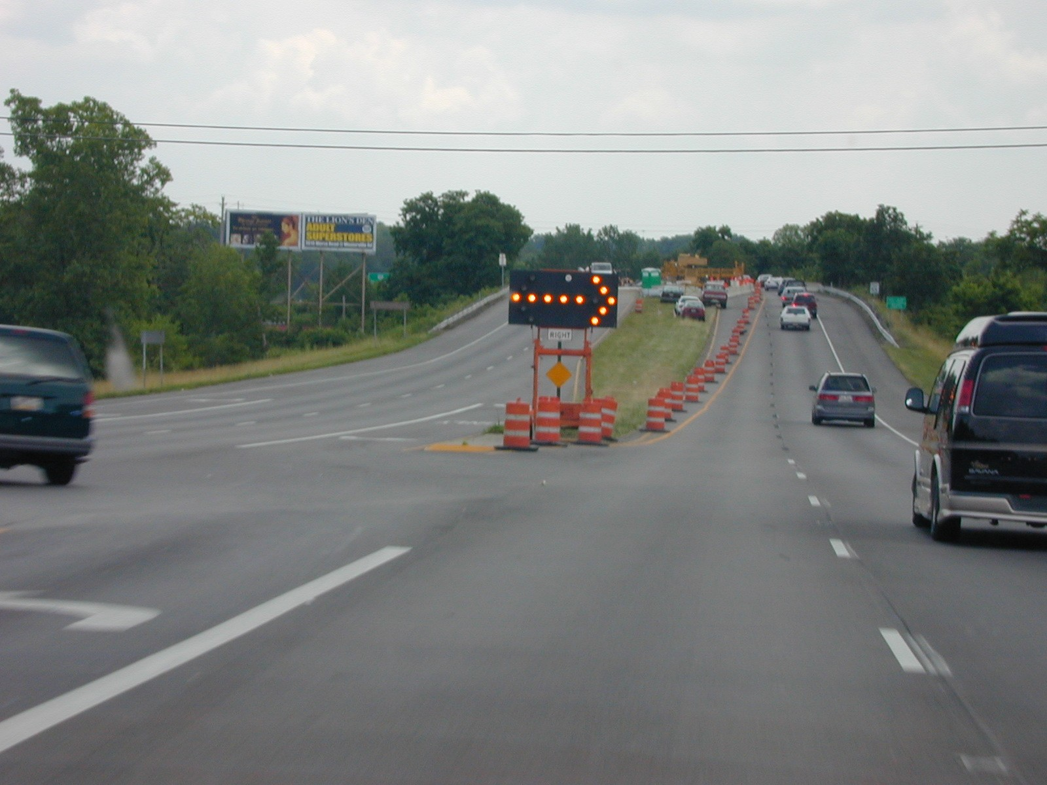
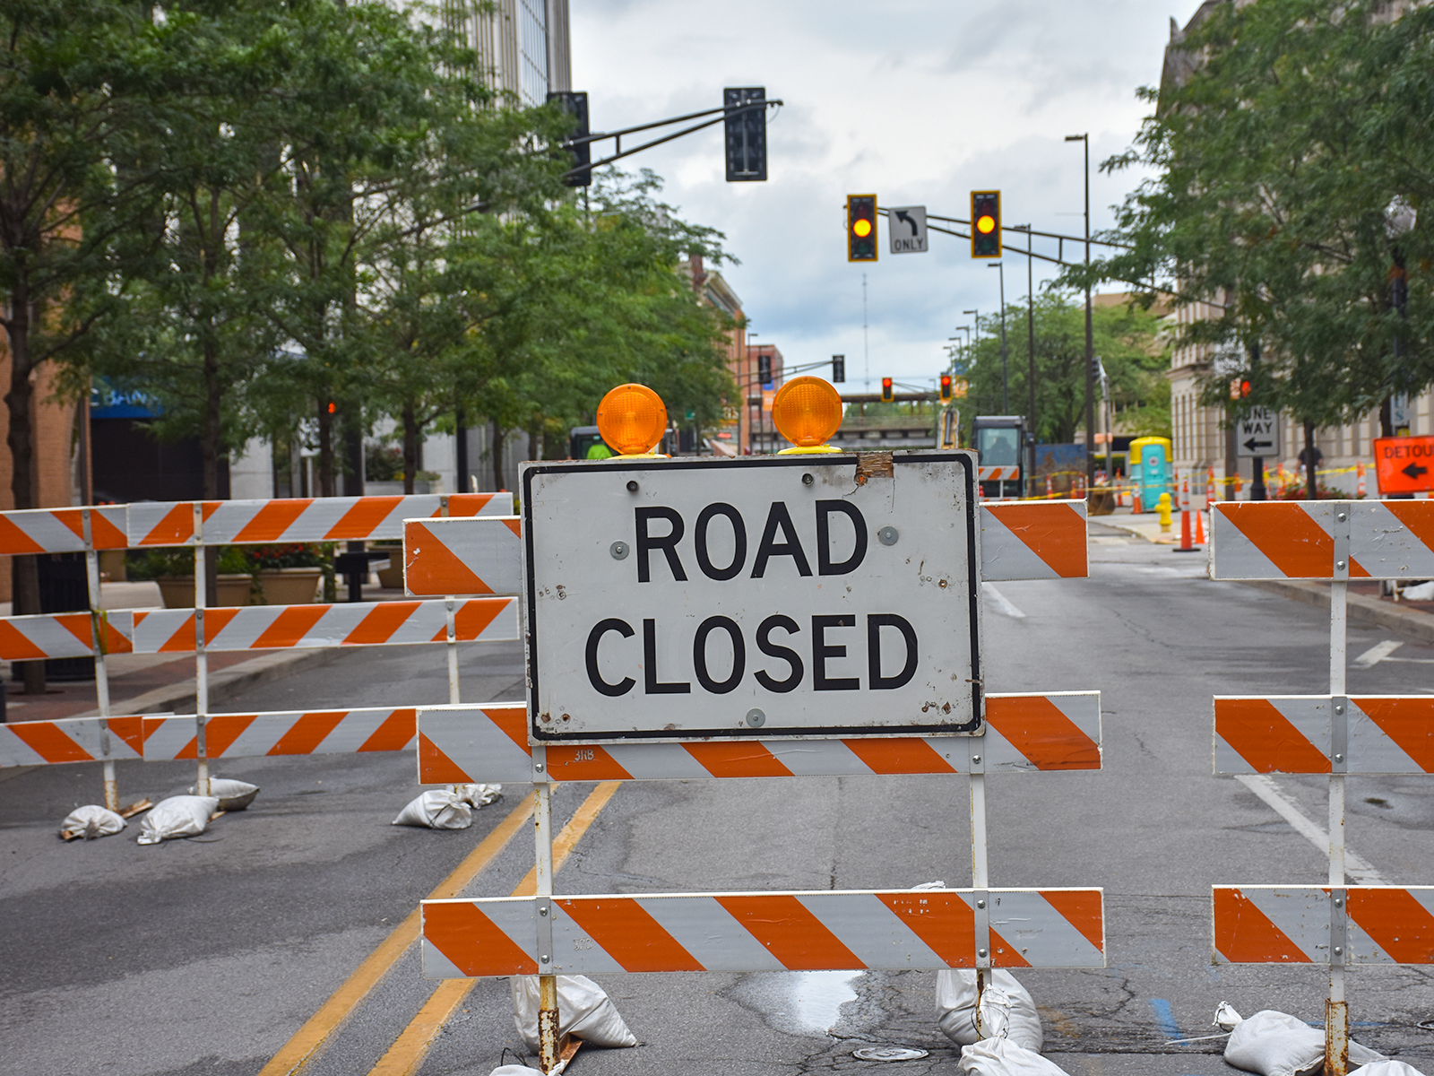
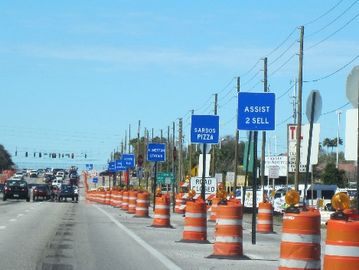
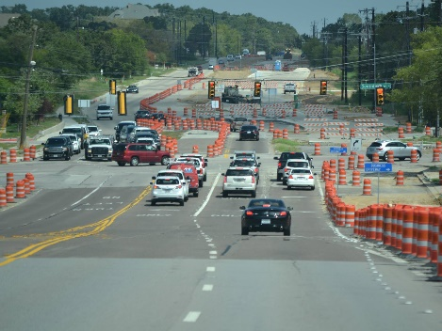
Work Zones Present Significant Challenges to CAVs
Temporary changes to allowable travel paths
  Lane/road closures
  Lane shifts to the shoulder or to new pavement
  Driveway access changes
  Lane use re-designations
Notes:
Lane use re-designation examples include closing a right turn only lane and converting the adjacent through lane to a shared through/right turn lane, restricting left turns at an intersection, changing a center two-way left-turn lane to a through lane, etc.
Right-of-way traffic control = law enforcement, flaggers, portable traffic signals, automated flagger assistance devices (AFADs), etc.
Key is in how to digitally convey these challenges to CAVs in an accurate and timely manner

Slide 6
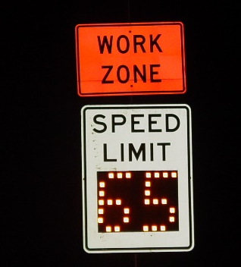
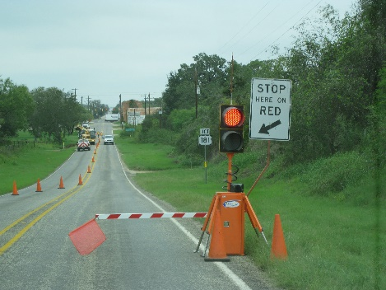
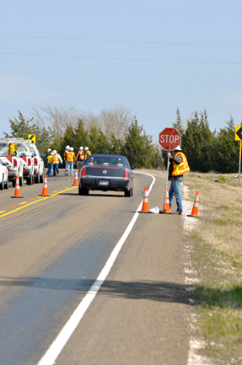
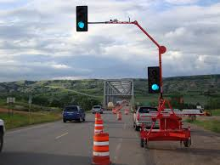
Work Challenges (cont’d)
Temporary traffic regulation changes
  Reduced speed limits
  New right-of-way traffic control
Notes:
Lane use re-designation examples include closing a right turn only lane and converting the adjacent through lane to a shared through/right turn lane, restricting left turns at an intersection, changing a center two-way left-turn lane to a through lane, etc.
Right-of-way traffic control = law enforcement, flaggers, portable traffic signals, automated flagger assistance devices (AFADs), etc.
Key is in how to digitally convey these challenges to CAVs in an accurate and timely manner

Slide 7
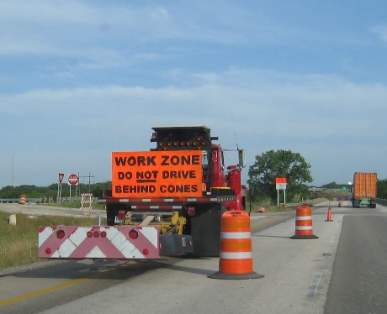
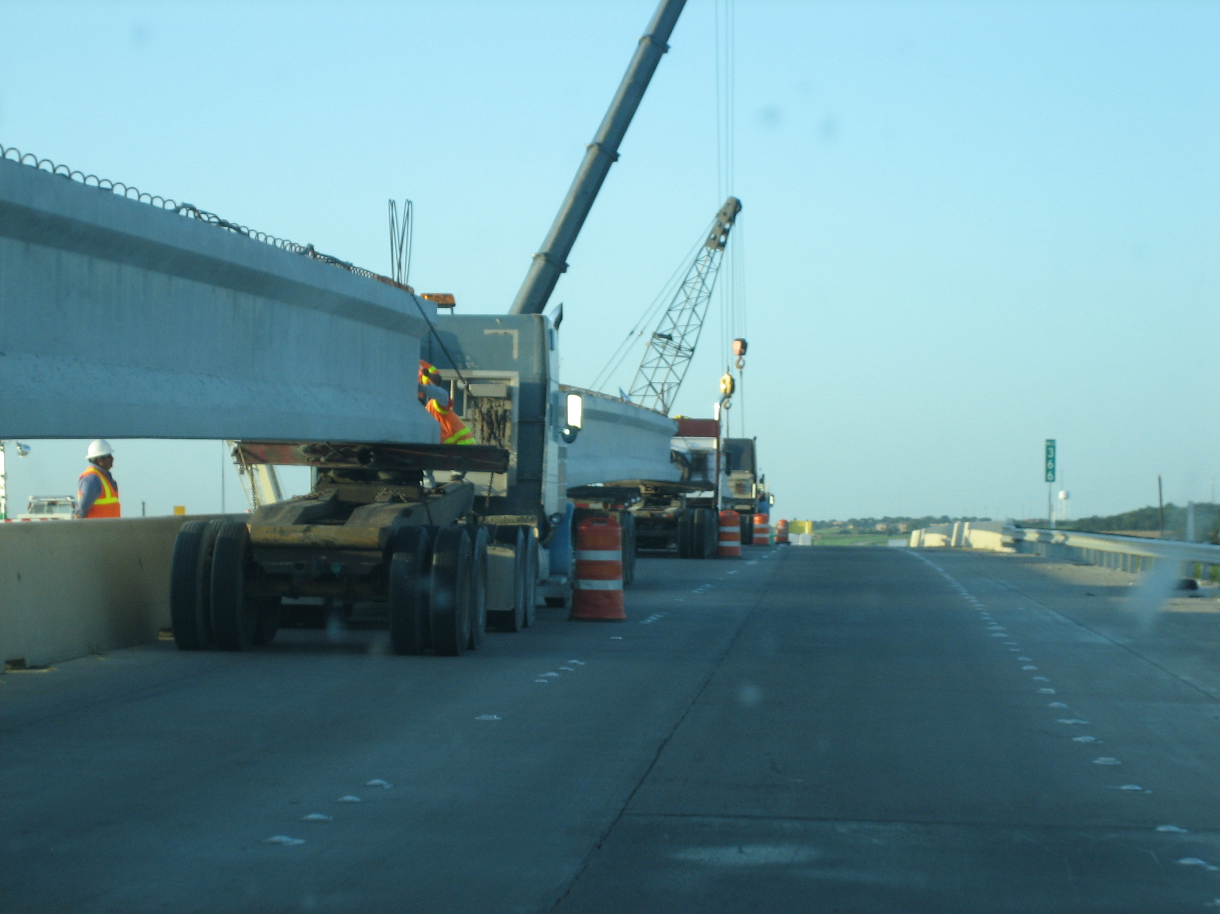
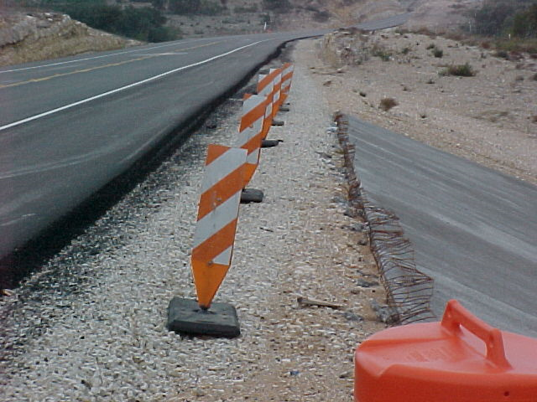
Work Zones Challenges (cont’d)
Temporary hazards
  Workers and equipment operating in close proximity to travel lanes
  Bumps/uneven lanes
Notes:
Lane use re-designation examples include closing a right turn only lane and converting the adjacent through lane to a shared through/right turn lane, restricting left turns at an intersection, changing a center two-way left-turn lane to a through lane, etc.
Right-of-way traffic control = law enforcement, flaggers, portable traffic signals, automated flagger assistance devices (AFADs), etc.
Key is in how to digitally convey these challenges to CAVs in an accurate and timely manner

Slide 8
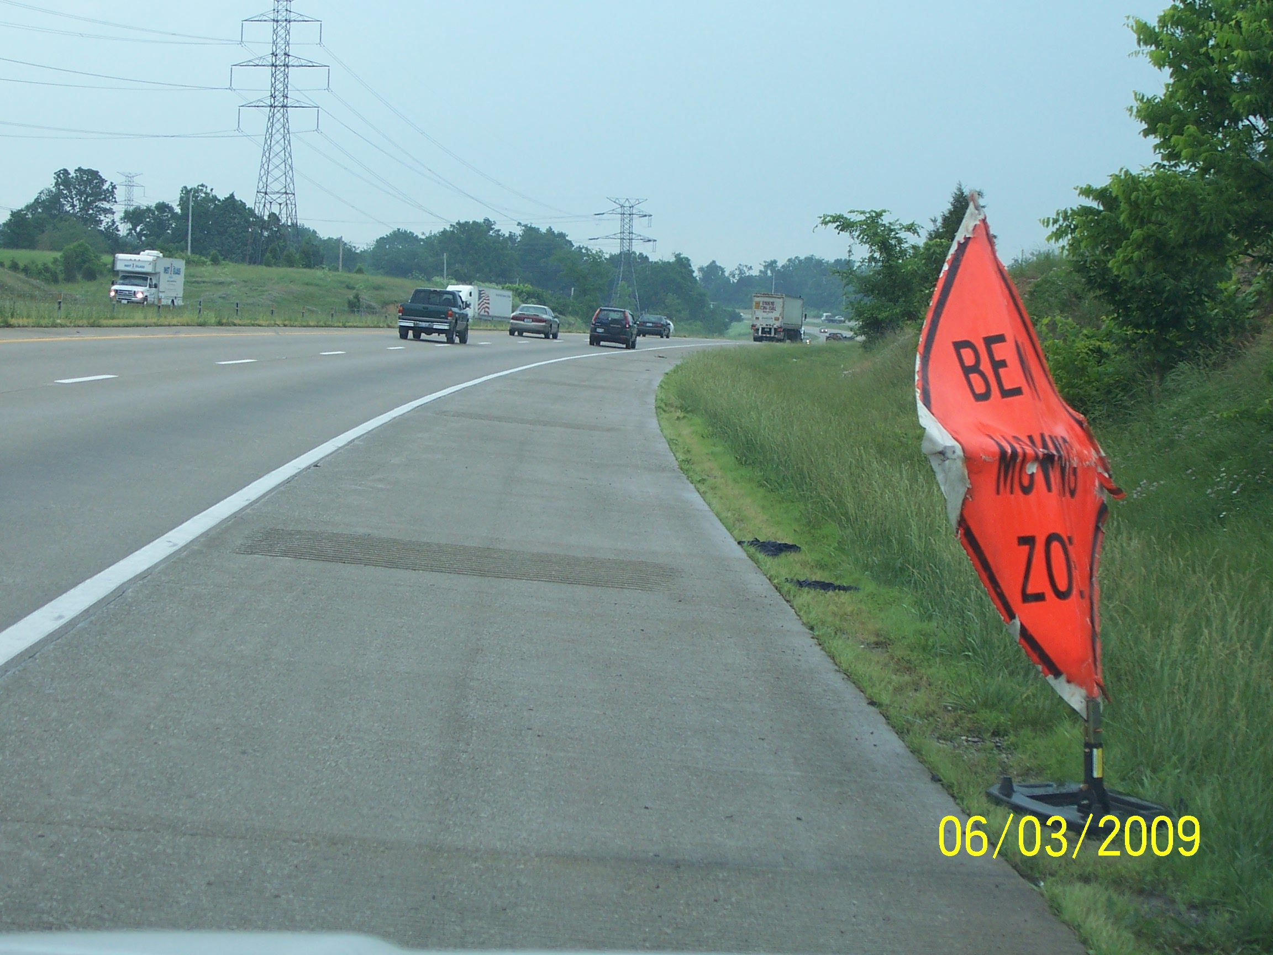
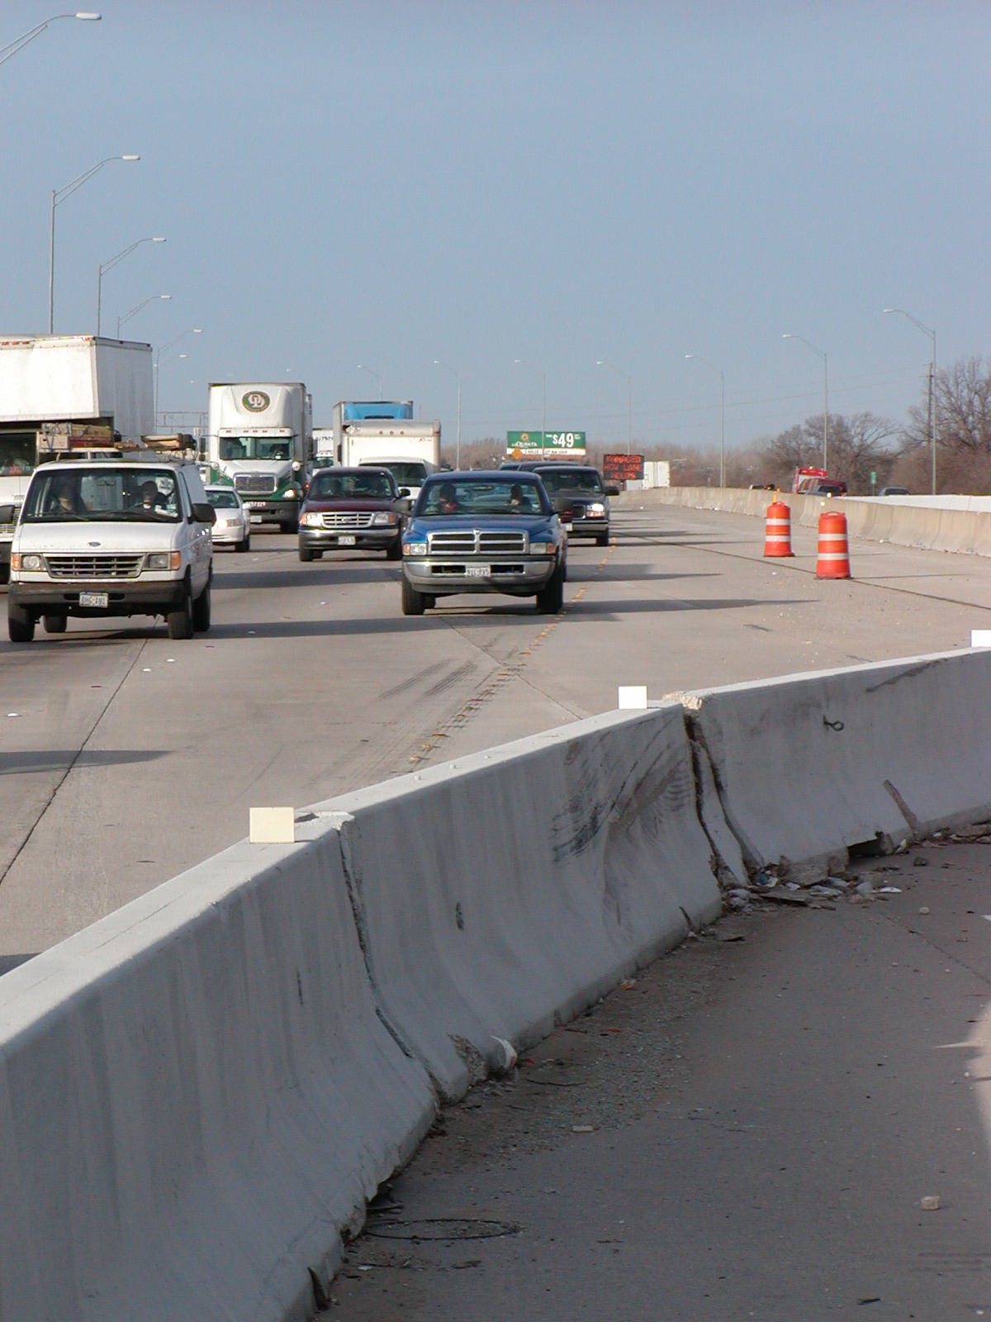
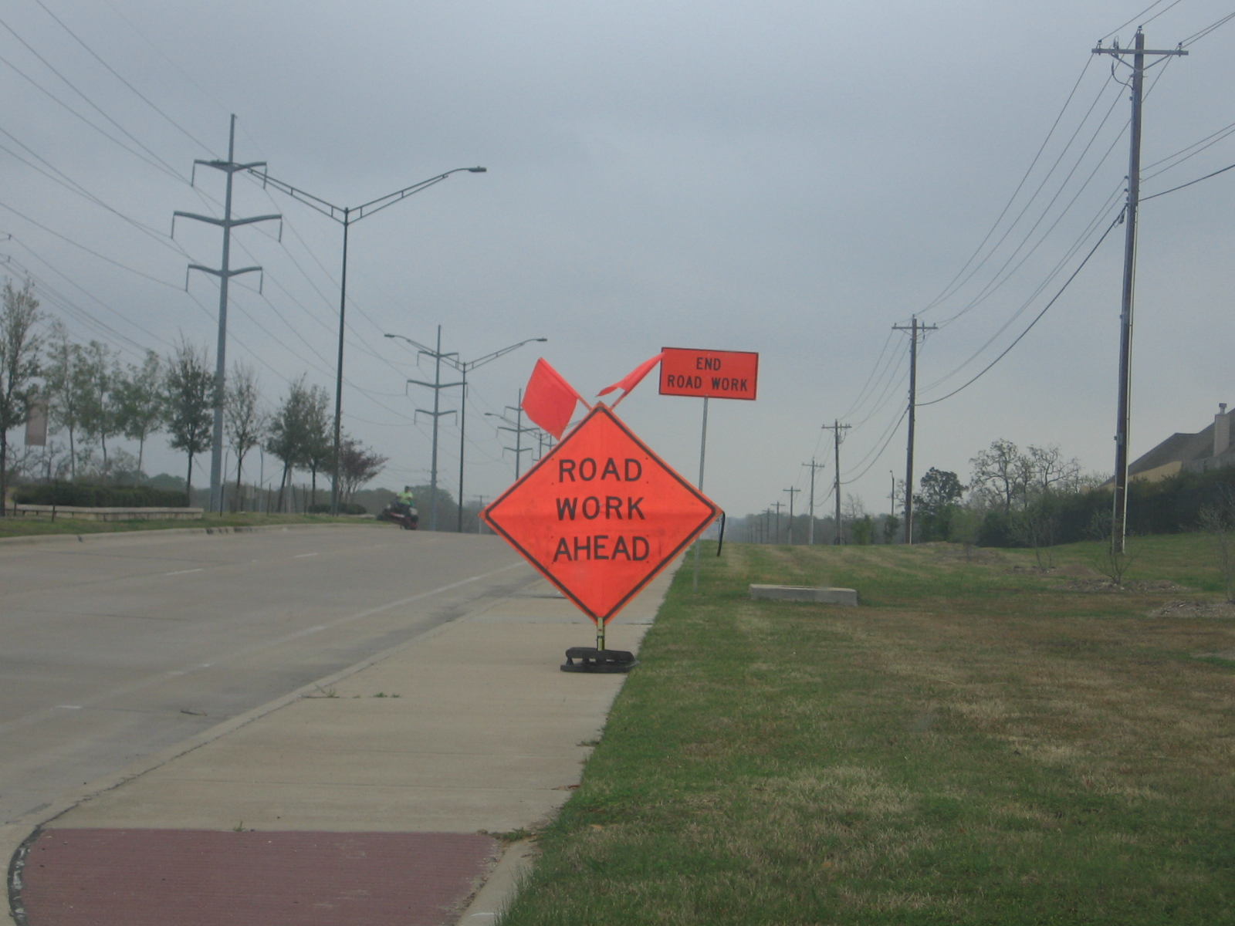
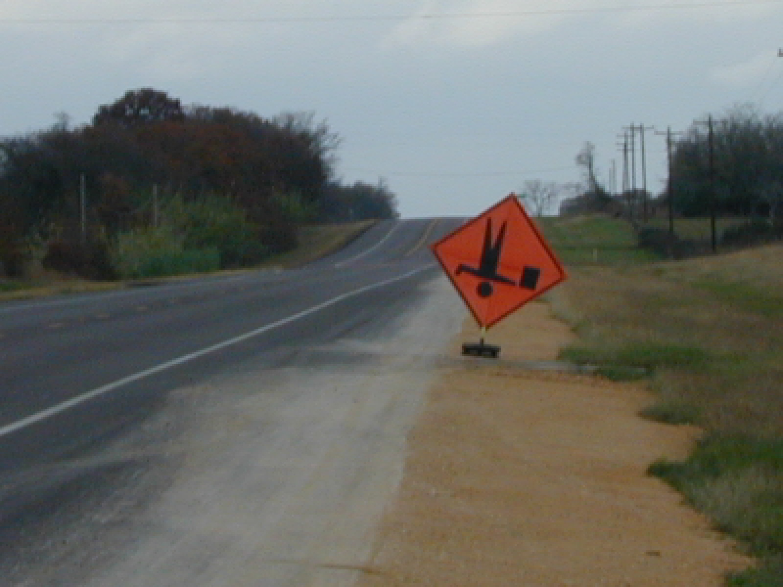
Work Zones Challenges (cont’d)
Improper or confusing signing, channelization, and/or markings
Notes:
Lane use re-designation examples include closing a right turn only lane and converting the adjacent through lane to a shared through/right turn lane, restricting left turns at an intersection, changing a center two-way left-turn lane to a through lane, etc.
Right-of-way traffic control = law enforcement, flaggers, portable traffic signals, automated flagger assistance devices (AFADs), etc.
Key is in how to digitally convey these challenges to CAVs in an accurate and timely manner

Slide 9
Accurate, Timely Work Zone Information (Data) Will Be Key!

Slide 10
The Driving Task
Examples of CAV Work Zone Information Needs
Begin/end locations and times Road closures/designated detour routes Expected/current traffic impacts
Changes in lane use assignment Real-time traffic control directions Temporary hazards that may affect driving task
Detailed allowable temporary travel path options
Navi-gation
Guidance
Control

Slide 11
Obstacles to Providing Needed WZ Data
Current WZ business processes
  Project delivery (task completion) focus
  Low bid emphasis
  Inconsistent device applications
  Inconsistent assessments of device compliance
Lack of definitive CAV information/data requirements
  Specifications on what needs to be provided
  Methods to evaluate/certify that what is provided meets specifications
Technologies to obtain and provide needed data
Notes:
Focus on project task completion approach to WZTC has not required significant attention to the data requirements listed on previous slide. This approach results in uncoordinated traffic control set ups (see photo of shortest wz ever) when task-oriented WZTC is overlapped onto one another.
Device inconsistencies include use of different types of channelizing devices, sometimes used to convey travel path different than what is conveyed by pavement markings, other times they are simply stored off to the side and not intended to be followed. Also includes incorrect device installation (i.e., upside down sign)
Inconsistent assessments of device compliance refers to quality level of signing, temporary pavement markings (and obliteration quality of existing markings), etc.

Slide 12
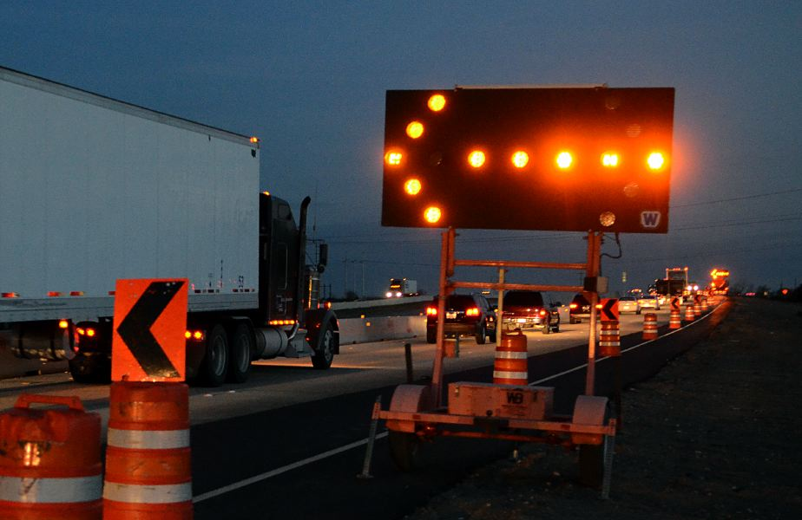
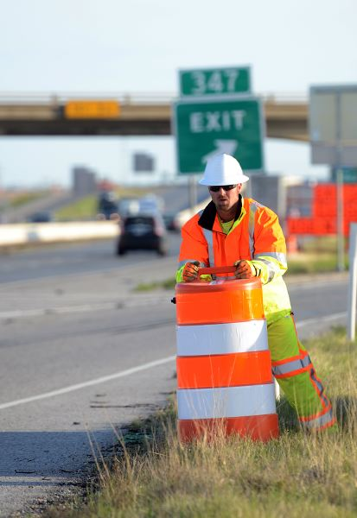
Connected Work Zone Technology Initiatives
Connected arrow panels
  Stationary
  Mobile operations
Other connected work zone traffic control devices
Connected worker vests
Establishing and maintaining situational awareness is a challenge
Notes:
Connected arrow panels report via cellular location and active status (which way arrow is pointing). Efforts underway in Minnesota to incorporate information into 511 website, other efforts elsewhere to feed into 3rd party traveler info systems. Similar concept for worker vests although no one is currently marketing and deploying yet (not really a market since no connected vehicles, and website notification of workers isn’t viewed as critical right now).
Manufacturers/vendors of smart work zones typically make location and operational data about work zones available, some push to 3rd party or agency websites.

Slide 13
USDOT Work Zone Data Exchange
Proof-of-concept effort
Facilitate sharing of currently available work zone data collected by agencies
  Set of common data elements
  Aggregation support
Demonstrate usability by various users
  Traveler information providers
  Freight haulers
  Connected vehicle developers
Notes:
Note: Iowa DOT is a participant in the WZDx, as is CO ROADx, Smart Belt Coalition members, and other

Slide 14
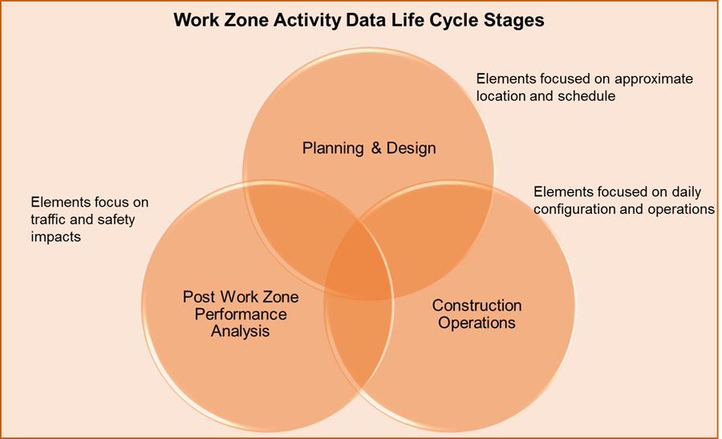
FHWA Work Zone Data Initiative
Establishing a consistent standardized framework for organizing, communicating, and using work zone activity data
Notes:
Note: the WZDI has stayed relatively high level relative to autonomous vehicle data requirements, as things are very uncertain as to how detailed wz info that changes quickly will be captured, digitized, and disseminated in near real-time in a manner that would serve the autonomous vehicle community

Slide 15
FHWA Work Zone Data Initiative
Draft use cases, framework, data dictionary available at https://collaboration.fhwa.dot.gov/wzmp
Pilot test opportunities exist (email interest to WZDI@dot.gov)
Notes:
Note: the WZDI has stayed relatively high level relative to autonomous vehicle data requirements, as things are very uncertain as to how detailed wz info that changes quickly will be captured, digitized, and disseminated in near real-time in a manner that would serve the autonomous vehicle community

Slide 16
Questions?
Gerald Ullman
979-317-2142
g-ullman@tti.tamu.edu

